Slide 1




PLAIN LANGUAGE & PEOPLE FIRST A Pioneering Union
1
Notes:
Image source: https://www.canva.com/photos/

Slide 2


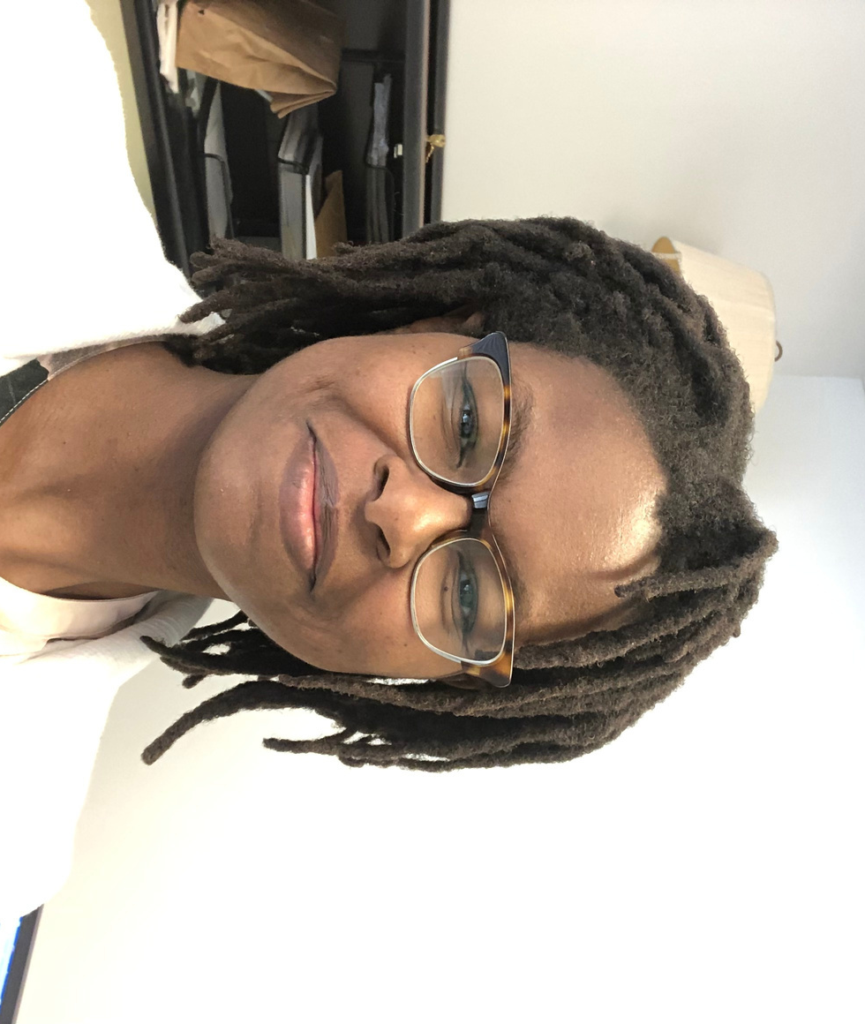

DONNA LEDBETTER
Technical Writer/Editor for the National Institute of Corrections
2
Notes:
Headshot of Donna Ledbetter, courtesy of Donna Ledbetter.

Slide 3

PURPOSE
This presentation will show how the National Institute of Corrections has been able to marry people-first language and plain language principles to develop more sensitive, humane communications that are respectful of the people directly affected by these words in various ways.
3
Notes:
Image source: https://www.canva.com/photos/

Slide 4
AGENDA
Introduction
Part 1: Setting the Stage
Part 2: Implementation
Part 3: The Future
Close
4

Slide 5
PART 1
Setting the Stage
5

Slide 6
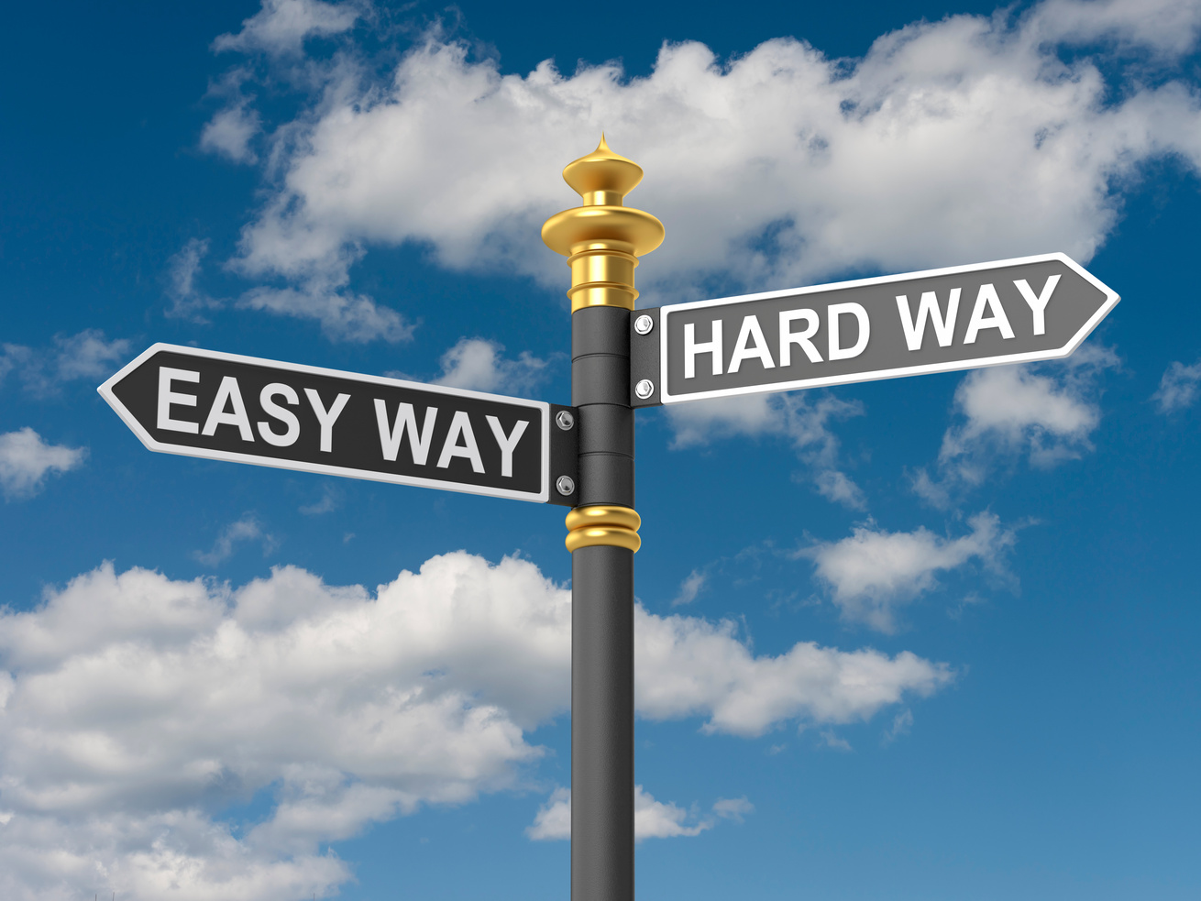

WHAT IS PLAIN LANGUAGE?
Plain language (PL) is writing that is simple and easy to understand.
6
Notes:
Image source: https://www.canva.com/photos/

Slide 7
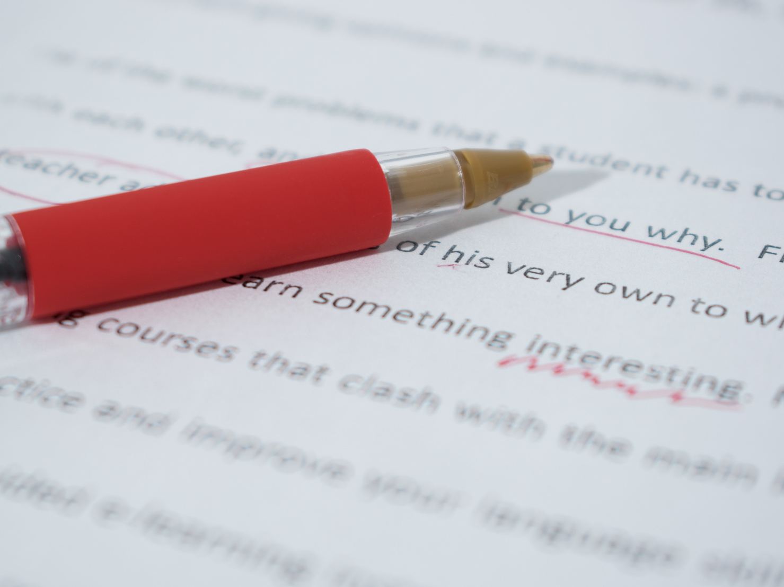

WHAT HAS PL MEANT TO ME AS THE TECHNICAL WRITER/EDITOR FOR MY AGENCY?
Exercise of skills beyond editing
Developing an agency voice, style, diction
7
Notes:
Image source: https://www.canva.com/photos/

Slide 8
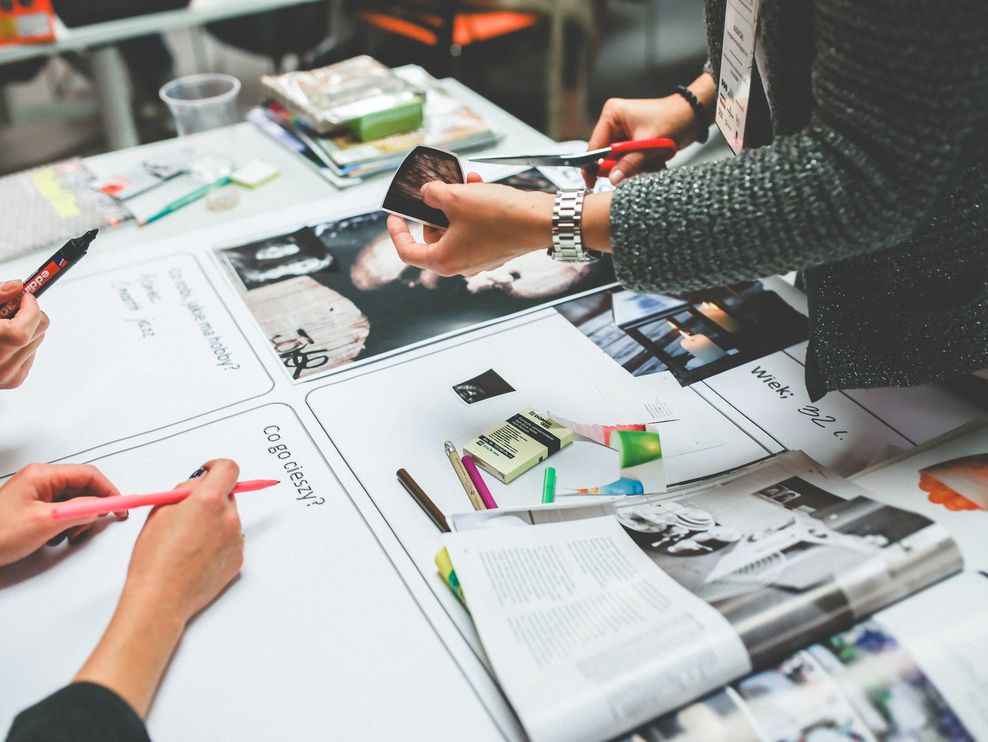
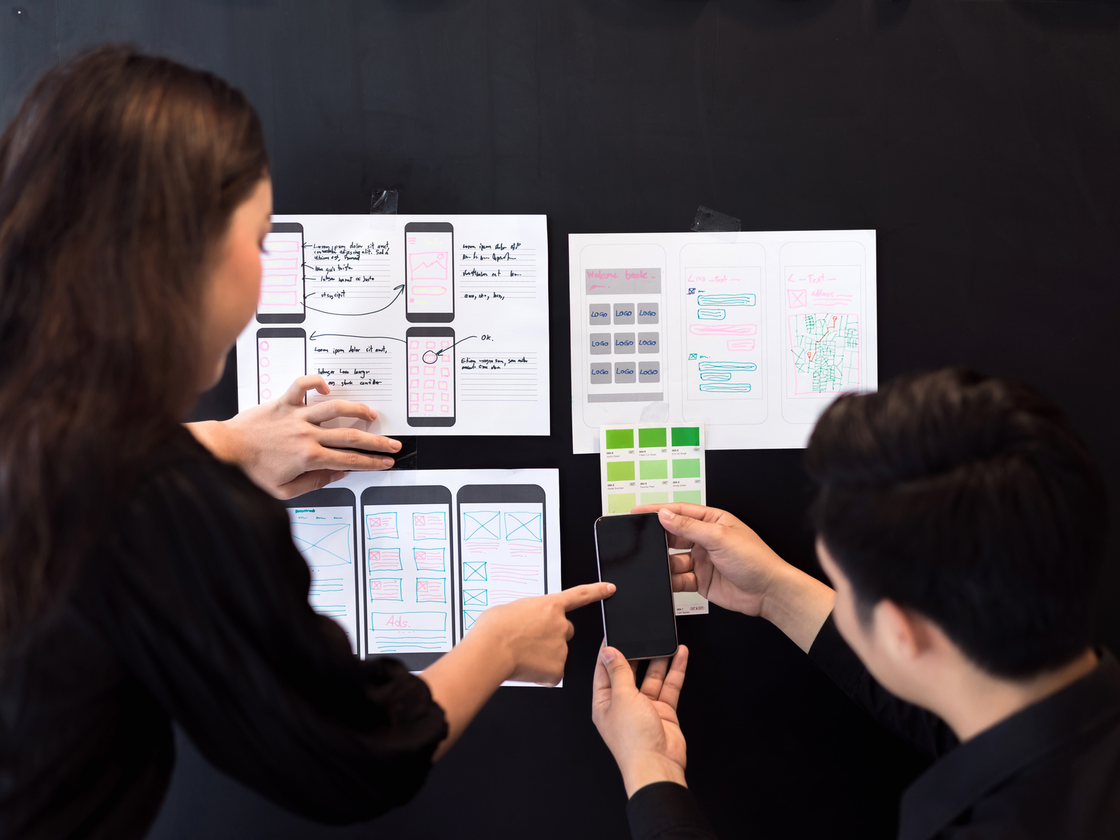
WHAT HAS BEEN THE INFLUENCE OF PL ON AGENCY?
Encourages creativity
Freedom to choose
Greater focus on reader and user experiences
8
Notes:
Image source: https://www.canva.com/photos/

Slide 9
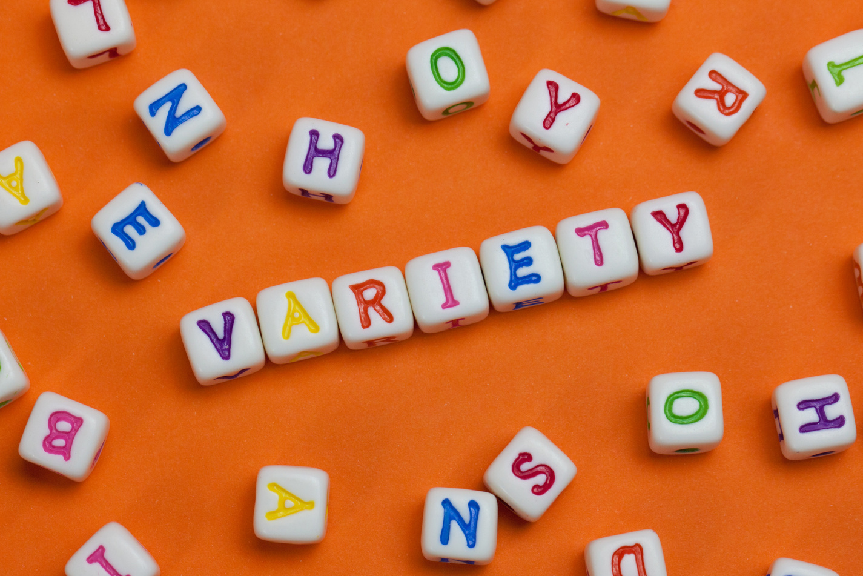

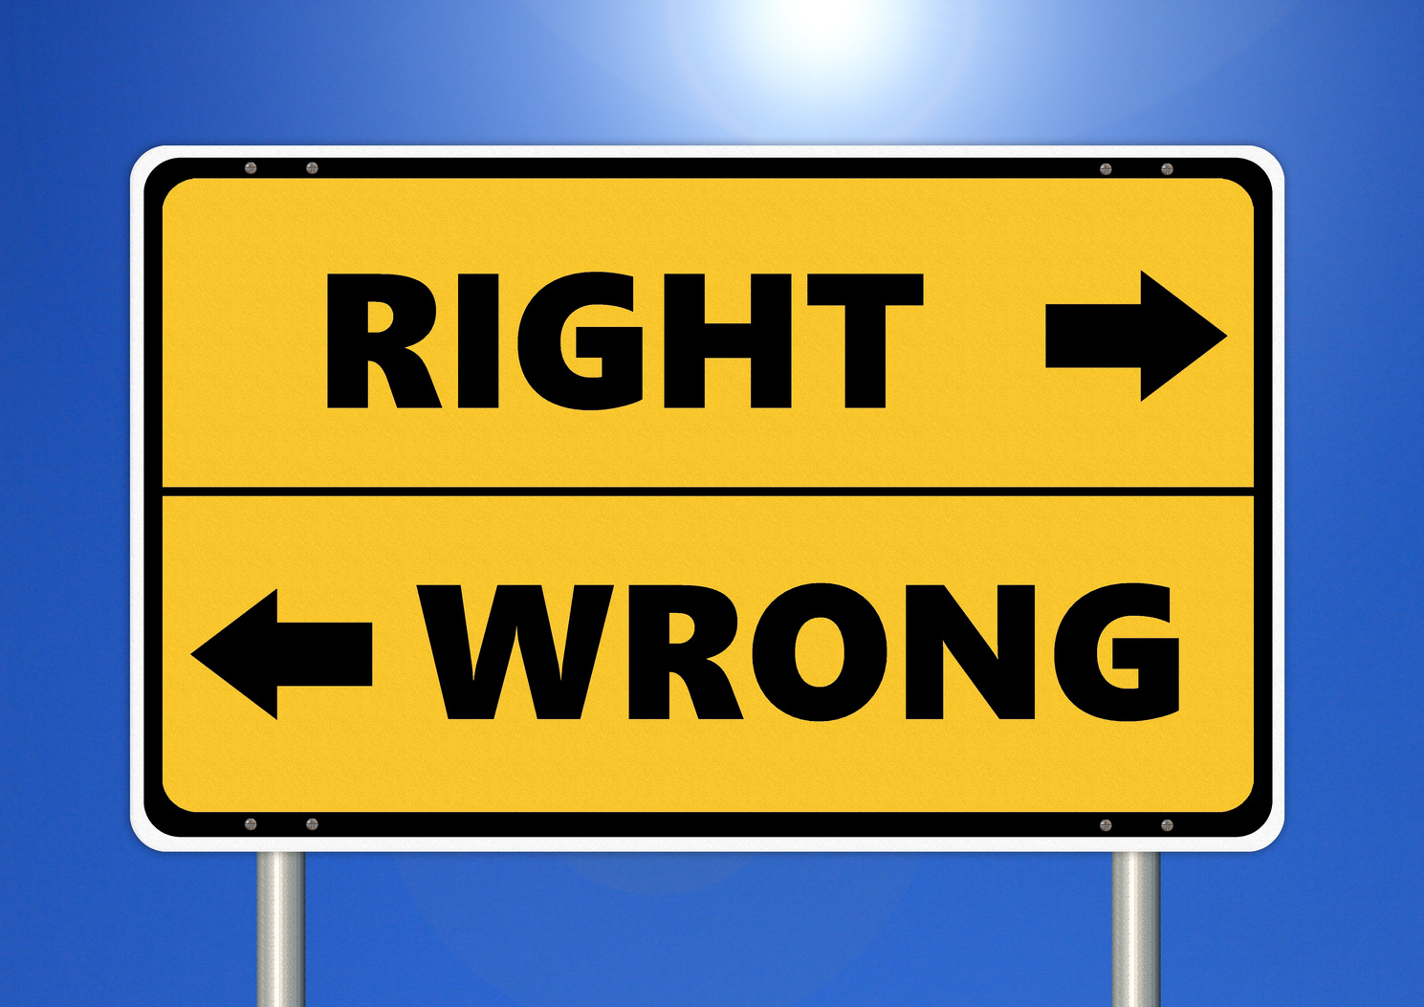
WHAT IS
PEOPLE-FIRST LANGUAGE?
Diction
Person-First, Politically Correct, Humanizing Language
Used in other areas such as medicine, social issues, government
9
Notes:
Image source: https://www.canva.com/photos/

Slide 10


WORD CHOICES
Instead of inmate, offender, parolee, probationer, etc., write:
Justice-involved individual
Person in custody
Formerly incarcerated individual
Person on community supervision
People in prison
Adult, man, woman, child, boy, girl
10
Notes:
Image source: https://www.canva.com/photos/

Slide 11

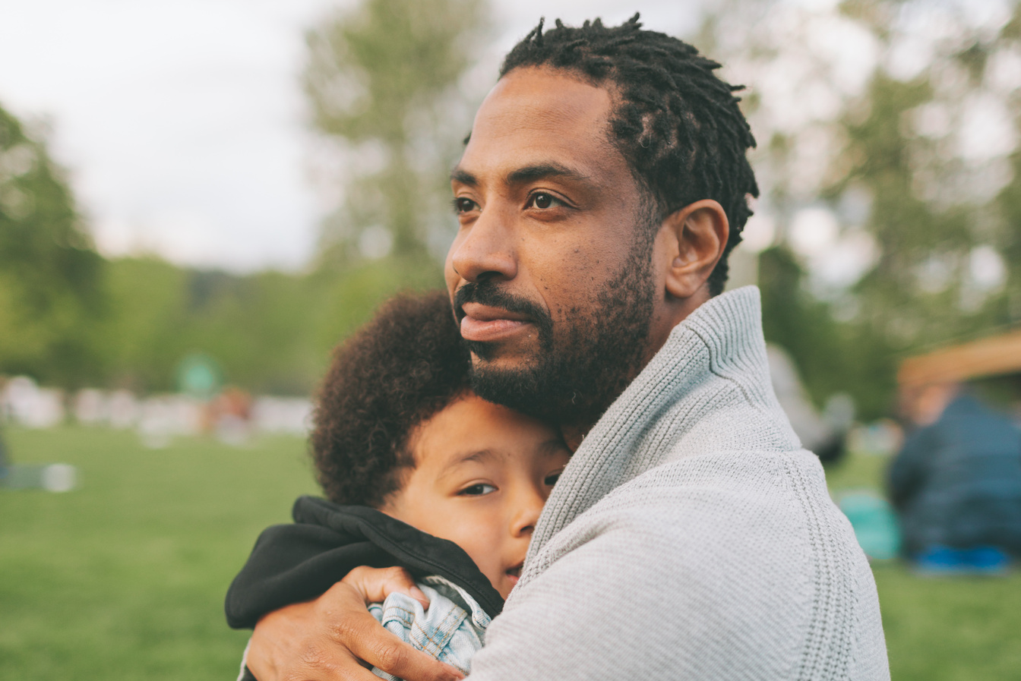
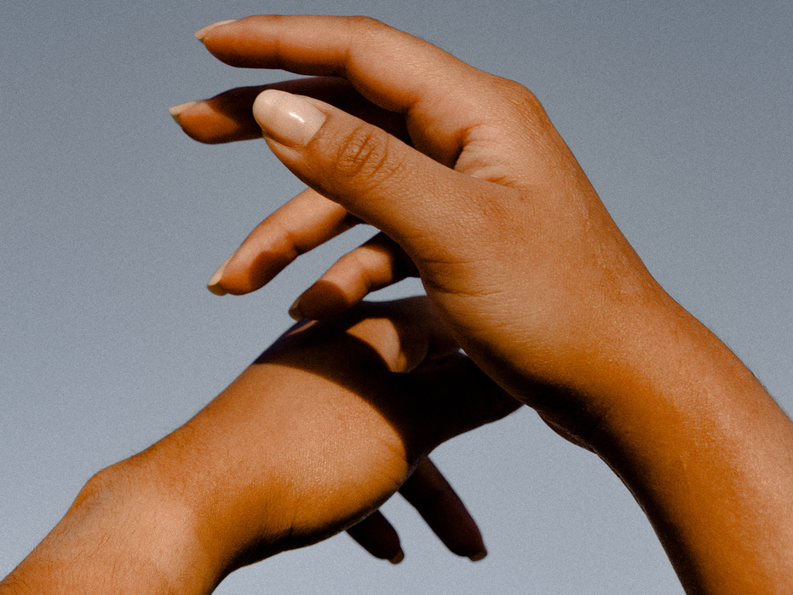
WHY DID WE DECIDE TO USE PEOPLE-FIRST LANGUAGE?
Acknowledges people's ability to change
Community recognizes people as human
Affects children (e.g., self-esteem, positive view of parent, acting out)
11
Notes:
Image source: https://www.canva.com/photos/

Slide 12
PART 2
Implementation
12

Slide 13
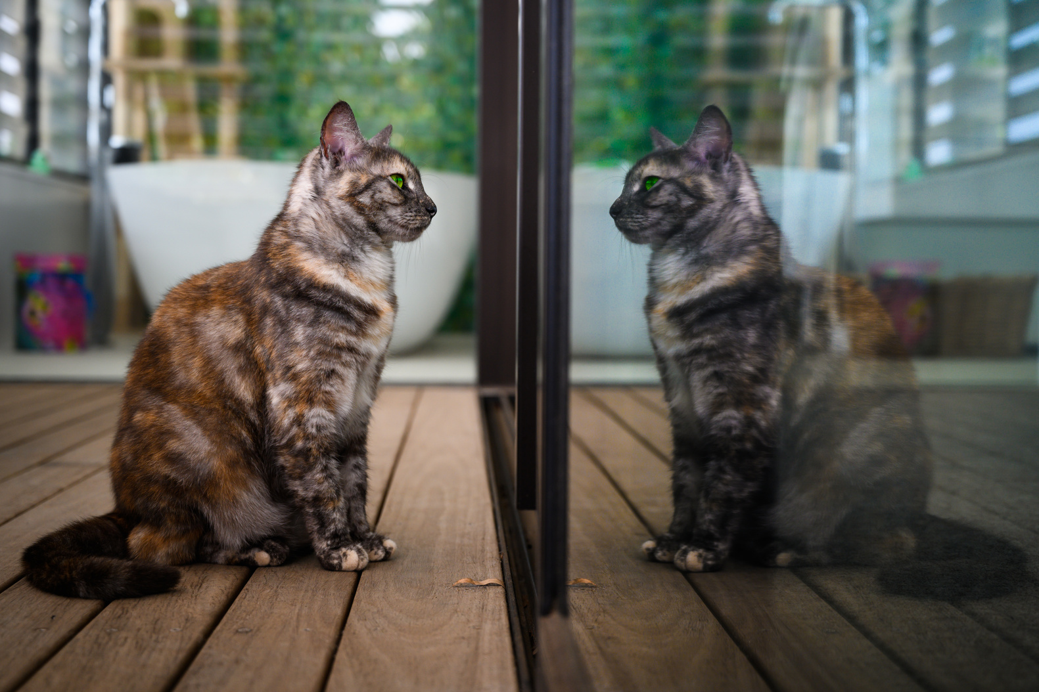


HOW DOES USE OF PL AND PEOPLE FIRST SPREAD AMONG STAFF?
Cultural shift
Avoiding or restricting use of old words when possible
Writing/Editing all documents moving forward with people first
Style guide
Informal training
Modeling
13
Notes:
Image source: https://www.canva.com/photos/

Slide 14

FAQ WILL PEOPLE KNOW WHAT YOU MEAN WHEN YOU USE OTHER WORDS?
Yes. We are not using words that people don’t understand or would never use. People can also gather meaning from context and other cues that a reader would use regardless of the situation.
14
Notes:
Image source: https://www.canva.com/photos/

Slide 15

FAQ DOESN'T IT MAKE YOUR DOCUMENT WORDY?
I don't think so. The Elements of Style encourages writers to omit needless words. While more words are used, they are not unnecessary.
15
Notes:
Image source: https://www.canva.com/photos/

Slide 16
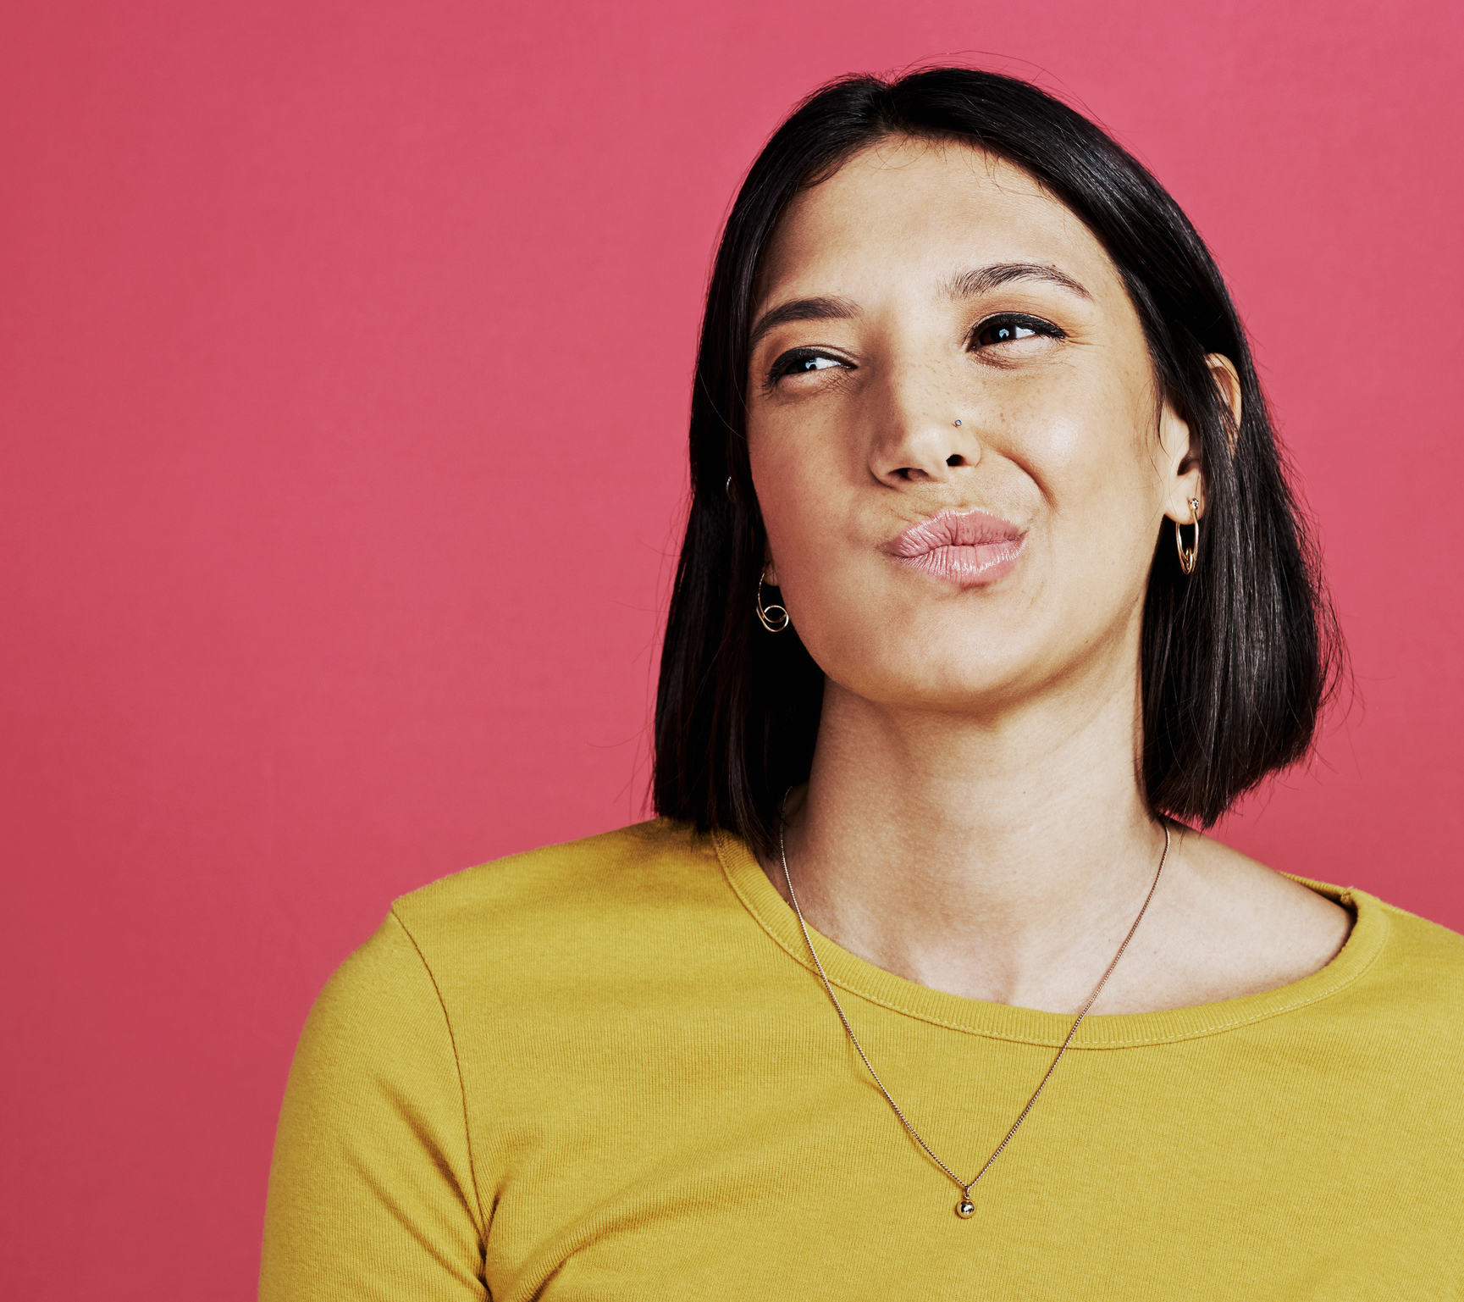
FAQ DO YOU HAVE TO GO BACK AND CHANGE ALL OF YOUR PAST PUBLICATIONS?
No. We fix the language in past publications as they are updated for different purposes. If there are no updates, the document stays the same.
16
Notes:
Image source: https://www.canva.com/photos/

Slide 17

FAQ DO YOU CHANGE THE NAMES OF PROGRAMS THAT USE THE OLD WORDS?
No. If an old word is part of the title of an existing program, we continue to use the old word in the title only. Elsewhere in the document we use a variant.
17
Notes:
Image source: https://www.canva.com/photos/

Slide 18

FAQ WHAT IF OTHER PEOPLE WANT TO CONTINUE TO USE THE OLD WORDS?
Let them. We model the behavior we want others to adopt.
However, note that we specify PL as a requirement in our contracts. Authors who do not submit acceptable publications have to update their work until they are in compliance.
18
Notes:
Image source: https://www.canva.com/photos/

Slide 19

FAQ ARE YOU CARRYING SIMILAR LANGUAGE OVER TO OTHER GROUPS, SUCH AS “VICTIMS” OR "SURVIVORS"?
Not all communities want to rid themselves of particular labels. People have a right to be called what they want as individuals and as a group. However, when we receive a clear signal that other communities are interested in such a change, it will be considered.
19
Notes:
Image source: https://www.canva.com/photos/

Slide 20
PART 3
The Future
20

Slide 21
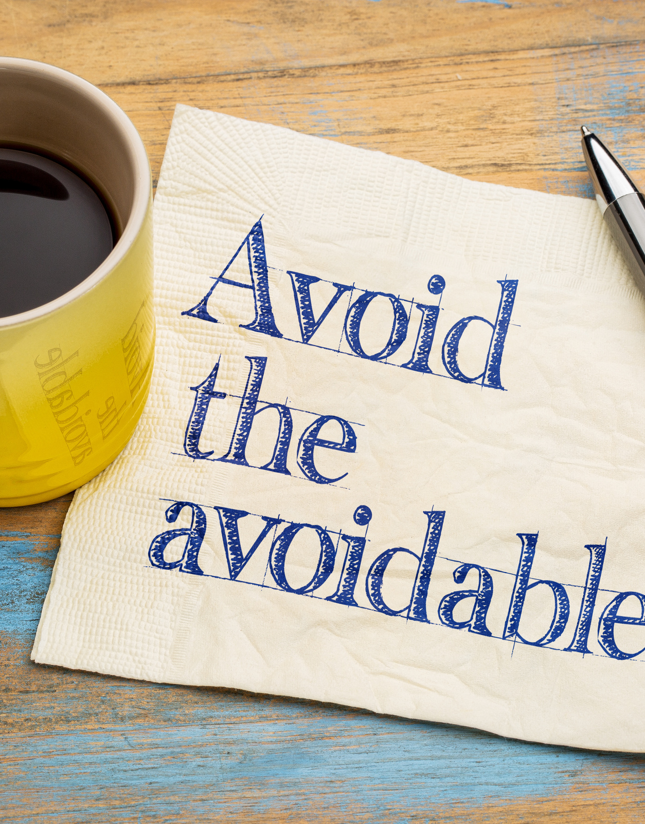
TRENDS
Titles of programs are slowly doing away with the words we want to avoid.
Justice-Involved Veterans
Justice-Involved Women
Employer Driven Model for Justice-Involved Individuals
21
Notes:
Image source: https://www.canva.com/photos/

Slide 22

TRAINING
All-staff training on plain language and use of people-first language.
Monthly staff meetings
Monthly division meetings
Annual training
One-one-one discussions
Lunch and learn
Modeling
22
Notes:
Image source: https://www.canva.com/photos/

Slide 23

QUESTIONS?
23
Notes:
Image source: https://www.canva.com/photos/

Slide 24
THANK YOU!
Donna Ledbetter
National Institute of Corrections
dledbetter@bop.gov
24

